Slide 1
What best explains man’s longing for… justice, spirituality, relationships, & beauty?

Slide 2
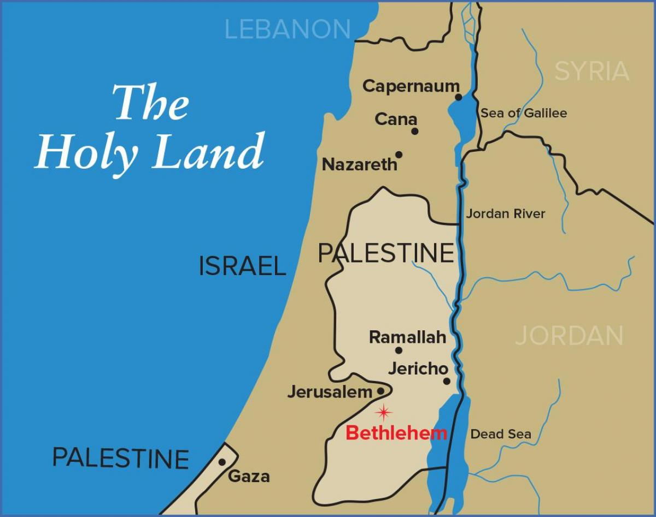
What was Israel hoping for?
[Gen 12:1-3]
I have chosen Abraham, that he may command his children to keep the way of YHWH by doing righteousness & justice… Gen 18:19
Why the world should reconsider the God of Israel and Jesus, the Shepherd & Hope of Israel!

Slide 3
4 Key Promises from the God of Israel
1) An Eternal Just King from David’s Lineage
In 1 Sam 8 God warns of injustices from kings. But in 2 Sam 7 God promises an eternal royal house of David. In [Psm 89:1-4 & 72:1-4] we learn the king rules with Justice. This is a good time to rejoice in [Isa 9:6-7]!
2) The King Would Build God’s House [2 Sam 7:8-15]
The focus became about The Temple building. No one could see in that moment what would come… in the first century a Spiritual interpretation is given. John 1-2

Slide 4
4 Key Promises from the God of Israel
1) An Eternal Just King of David’s [Isa 9:6-7]
2) Would Build A Divine Spiritual House [2Sa7:8-15]
3) There Would Be A New Law, New Relationship
Jesus summarized The Law: Love God & Love Your Fellow Man The Prophets promised a New Way: [Jer 31:31-33] This Law would create a new relationship with God!
4) A New Beautiful Creation (A Return to Eden)
The Lion lays with the Lamb, ALL are in harmony. (Isa 2, 11) God invites us to experience His JOY [Isa 55:1-9, 12-13]

Slide 5
4 Key Promises from the God of Israel
1) An Eternal Just King of David’s [Isa 9:6-7]
2) Would Build A Divine Spiritual House [2Sa7:8-15]
3) There Would Be A New Law, New Relationship
4) A New Beautiful Creation (A Return to Eden)
The Gospel of Isaiah: From the cradle to the cross… God’s Servant fulfills the hopes of man! [Isa 53:10-12] Why else would the world turn its gaze on such a King? Born that men no more may die! Born to raise the sons of earth!

