Slide 1
Sons of Light –Light in The Gospels

Slide 2
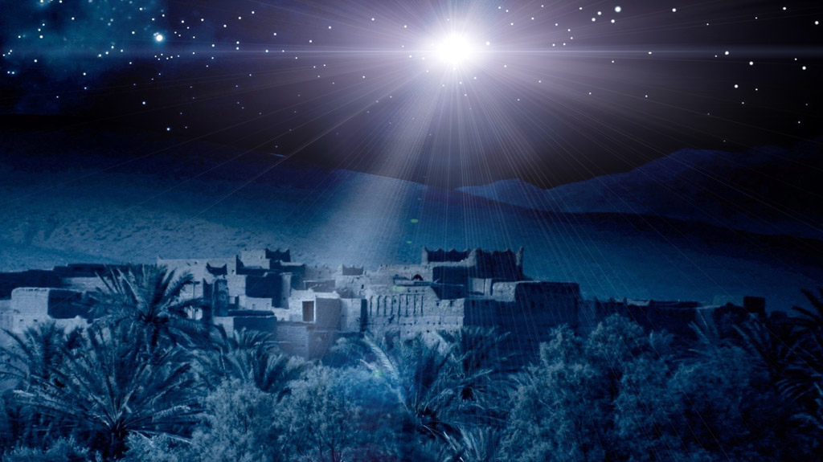
1) The Light at Christ’s Birth [Lk 1 & 2]

Slide 3
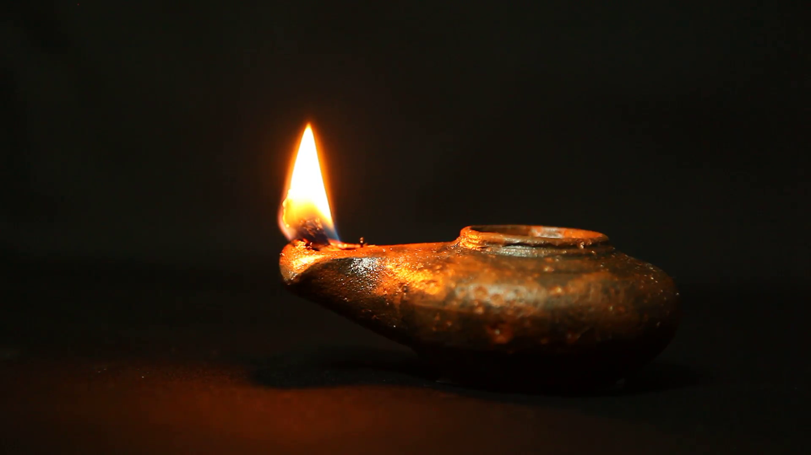
2) Christ-Lights In the Darkness [Mt 5-6]

Slide 4
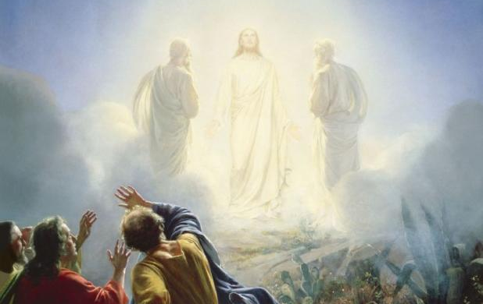
3) The Transfiguration
Mt 17; Mk 9; Lk 9

Slide 5
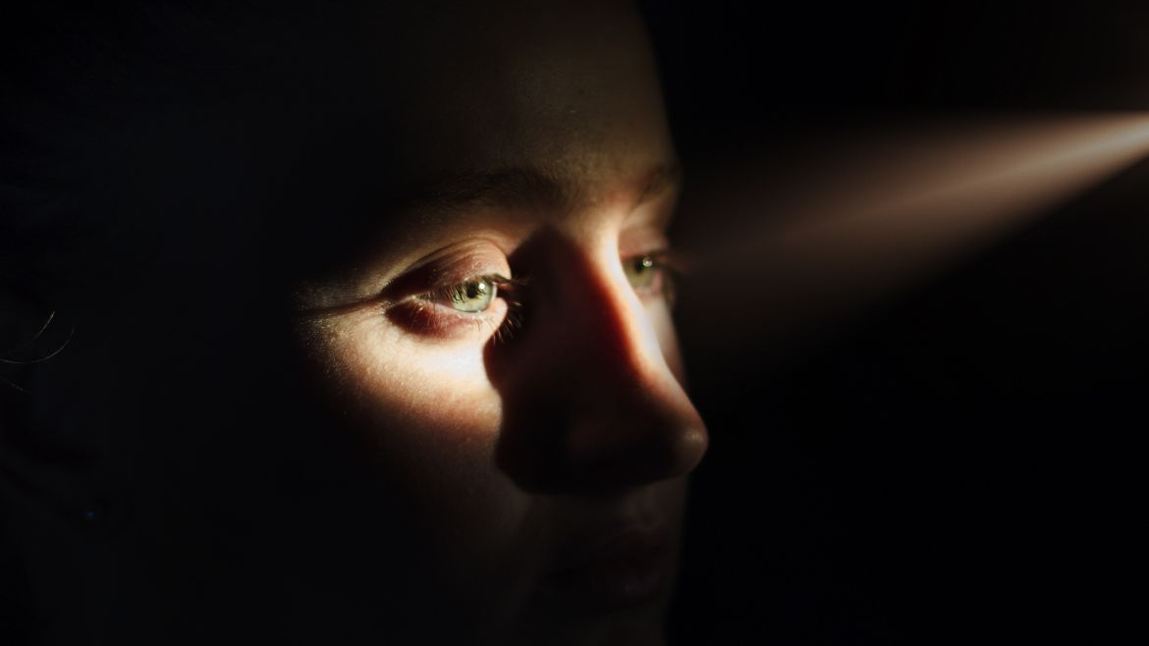
4) Healthy Eyes & Lighted Bodies [Lk 11]

Slide 6
5) Sons of Light Need Discernment

Slide 7
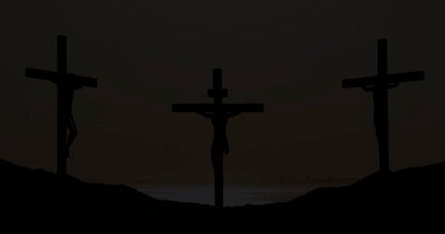
6) Darkness At His Death
This darkness Thallus, in the third book of his History, calls, as appears to me without reason, an eclipse of the sun… The Passion of our Savior falls on the day before The Passover; but an eclipse of the sun takes place only when the moon comes under the sun… Phlegon records that, in the time of Tiberius Caesar, at full moon, there was a full eclipse of the sun from the sixth hour to the ninth – manifestly that one of which we speak. …it was a darkness induced by God.

Slide 8
6) Darkness At His Death
Darkness induced by God…
The 3hrs allude to SEVERAL OT verses:
Ex 10:23; Jer 15:9; Gen 1:2; Isa 50:3; Ezk 9; Joel 2; Zeph 1
Two in [Amos 5:18-20; 8:4-10] And finally [Isa 60:1-5a]

Slide 9
7) At His Return… will we be Christ-Lights In the Darkness?

