Slide 1
Children of Light [Eph 5:8-16 & 1 Th 5:1-11]

Slide 2
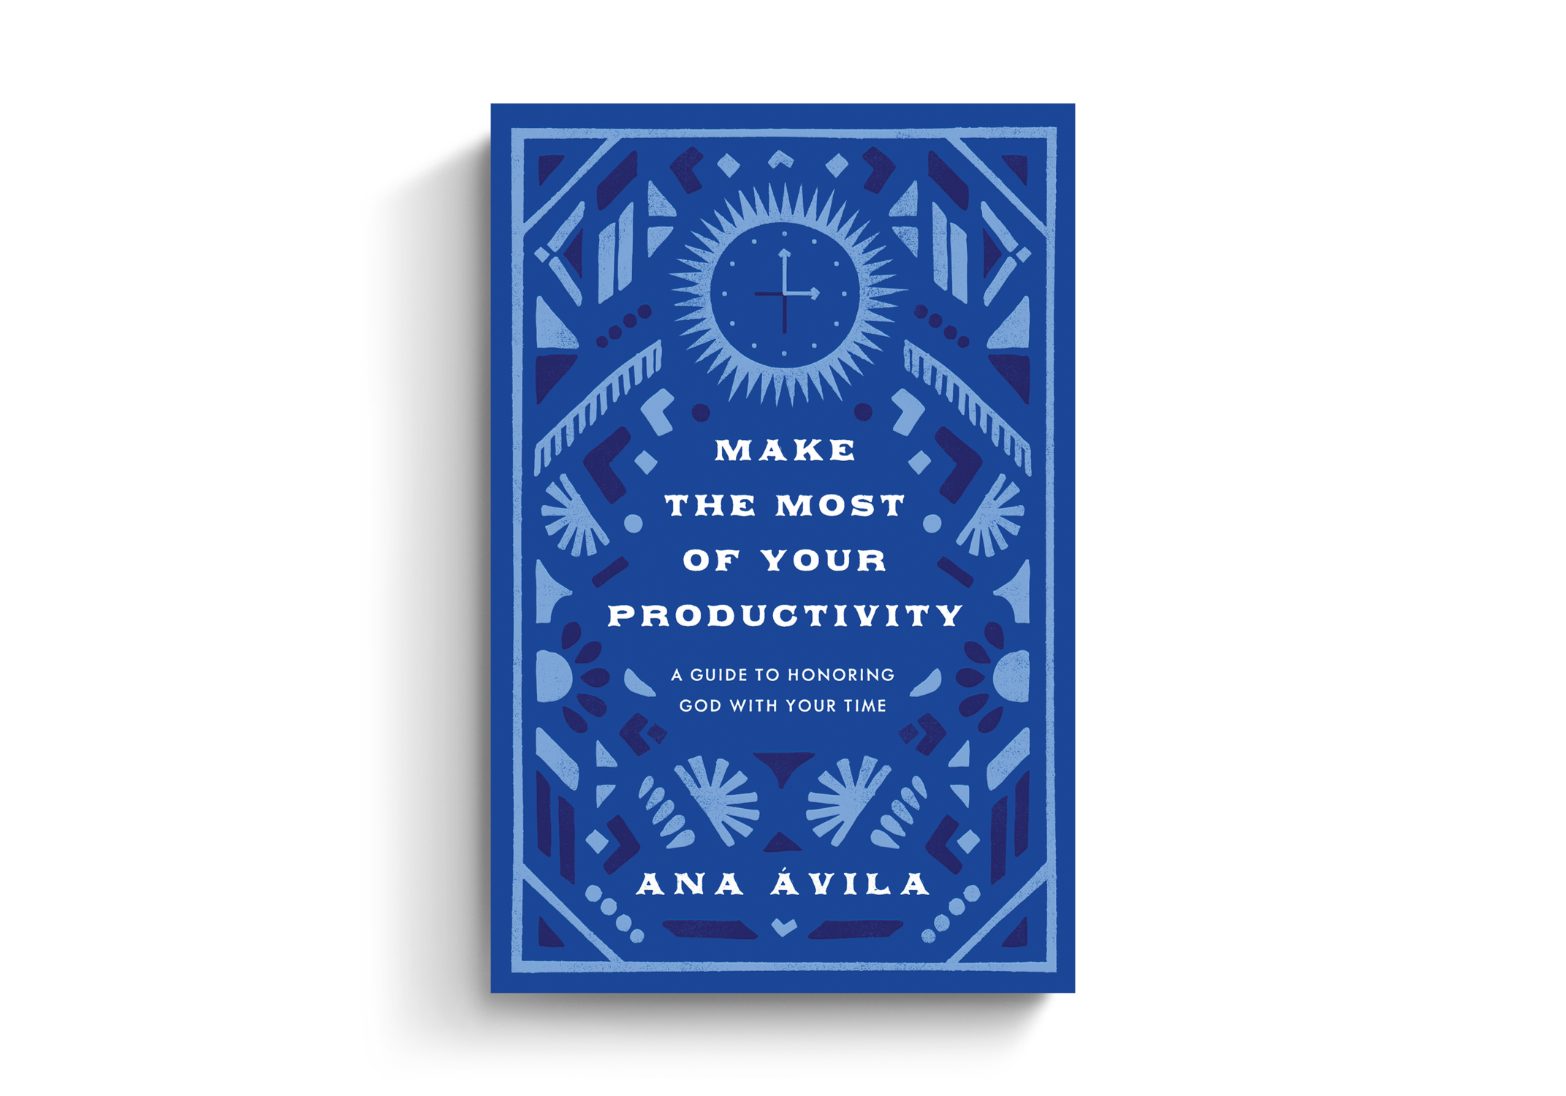
Children of Light = Time Managers Eph 5:8,16

Slide 3
Prayer: Col 4:2, 12 NEVER see this as unproductive!
Do the Work: Matt 7 Faith=Action [Neh 2:1-8].
Get Tools: [Eph 6:5-20] Don’t justify procrastination. “The perfect is the enemy of the good.”
“No decision is still a decision.” [Ja 4:13-17] Scripture DOESN’T teach inaction. [Matt 6:25-34]
Be Patient With Interruptions Mt 19; [14:12-16]
“It is a profoundly important message... Do not put off what you have to do in your life until the times are optimal. Because they never were optimal, & they never will be.”
-D Murray on C.S. Lewis’ “Learning in War”
Children of Light = Godly Productivity Eph 5:8,16

Slide 4
Prayer: Col 4:2, 12 NEVER see this as unproductive!
Do the Work: Matt 7 Faith=Action [Neh 2:1-8].
Get Tools: [Eph 6:5-20] Don’t justify procrastination.
“No decision is a decision.” [Ja4:13-17; Mt6:25-34]
Be Patient With Interruptions Mt 19; [14:12-16]
Get Some Sleep [Mk 4:35-41; Pr 3:19-27; Ps 127:2] “You can’t work well if you don’t sleep well.” –A. Avila
Plant Seeds [1 Cor 3:5-11, 4:1-5] (May not see fruit.) Don’t: Compare, Condemn, or Complain Gal 6:9-10
Children of Light = Godly Productivity Eph 5:8,16

