Slide 1
Romans Outline
Ch 1-4 God’s Righteousness & Justification through Christ
Ch 5-8 “Those He justified, He also Glorified.” 8:30
Ch 9-11 God graciously kept His promises to ALL Israel & Gentiles
Therefore, Ch 12-15, live as transformed people! [12:1-2]
Part of this, [13:11-14]. Put on The Armor of Light!

Slide 2
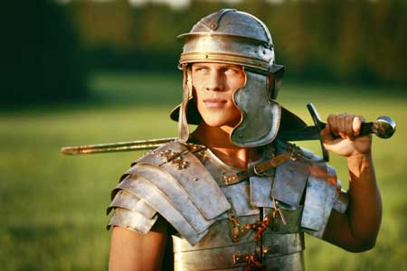
The Armor of Light
Romans 13:11-14
1 Thess 5:1-11
Eph 6:10-20

Slide 3
The Armor of Light
4 Macc 13:9-17 (NRSV) 9“Brothers, let us die like brothers for the sake of the law; let us imitate the three youths in Assyria who despised the same ordeal of the furnace. 10Let us not be cowardly in the demonstration of our piety.” 11While one said, “Courage, brother,” another said, “Bear up nobly,” 12& another reminded them, “Remember whence you came, & the father by whose hand Isaac would have submitted to being slain for the sake of piety.” 13Each of them & all of them together looking at one another, cheerful & undaunted, said, “Let us with all our hearts consecrate ourselves to God, who gave us our lives, & let us use our bodies as a bulwark for the law. 14Let us not fear him who thinks he is killing us, 15for great is the soul’s contest & the danger of eternal torment lying before those who transgress the commandment of God. 16Therefore let us put on the full armor of mastery of the passions that divine reason provides. 17For if we so die, Abraham & Isaac & Jacob will welcome us, & all the fathers will praise us.”
1) Love Neighbors [Rom 13:8-10]
Jesus’ 2nd Great Command. [Php 2:1-4]
2) Paul’s “Call to Arms” [2 Tim 2:1-7]
Jewish & Greco-Roman culture knew war.
For example, a Dead Sea Scroll title: War of The Sons of Light & Sons of Darkness
And in Jewish history, 4 Maccabees 13:16
Influencing NT language: [Eph 6:10-12]
Romans 13:11-14

Slide 4
The Armor of Light
3) Wake up! [Rom 13:11]
Keep a sense of urgency, don’t let hope die.
4) Cast off the works of darkness! [13:12]
Get rid of sin, put on divine protection.
5) Walk properly [13:13]
Avoid things like these [Gal 5:19-21]
6) Put on the Lord Jesus Christ [13:14]
Christian identity. [Col 3:1-4] Do we ‘fit in’? [1P 4:1-8]
7) Don’t let Satan divide us!
[14:1-6, 12] Stand firm!
Romans 13:11-14

