Slide 1
Walking In The Light
Readings in 1 John

Slide 2
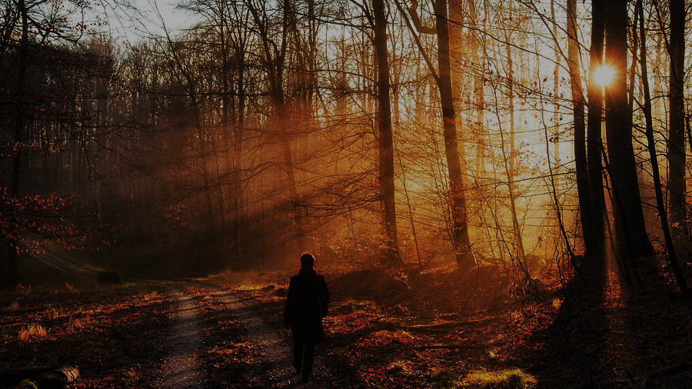
Walking In The Light
1) KNOW You Have Eternal Life [1 Jn 5:11-15] False teaching had caused uncertainty [1 Jn 4:1-6]
Today some have doubts for various reasons.
Be confident in what the apostles revealed. 4:6
2) The Foundation: God Is Light [1 Jn 1:5-7]
Walking in light requires practicing the truth. Thankfully, confession brings forgiveness [v8-10].
This assurance doesn’t mean we should sin more [2:1-6].
3) Walking In The Light=Walk Like Jesus Walked
Remember, Jesus’ walk included growing & learning:
Luke 2:52 grew in favor Heb 5:7-9 learned obedience.
Our transformation into His image isn’t immediate.

Slide 3
Walking In The Light
3) Walking In The Light=Walk Like Jesus Walked
4) Walking In The Light=Brotherly Love [2:7-11]
Jesus’ example was sacrifice. Willing to hurt. [3:16-19]
The cause of ‘stumbling’ is echoed in [Rom 14:12-20].
John knew a disciple who’d lost this focus: [3 Jn 5-11].
5) Walking In Light=Practicing Righteousness [5:1-5] This is clear throughout the NT [2 John 4-11]. Jn 14
[1 Jn 3:10] Puts love & righteousness together.
We don’t mean perfection is needed [1 Jn 3:4-9].

Slide 4
Walking In The Light
3) Walking In The Light=Walk Like Jesus Walked
4 & 5) Requires Brotherly Love & Righteousness
6) Walking Indicates Progress on a Journey
[1 John 2:12-14] We grow through stages, not ages.
Several NT verses make similar points:
Hebrews 5:12-6:3 They should have matured.
Ephesians 4:12-16 Grow toward attaining maturity.
1 Cor 2:14-3:4 Paul is frustrated at their stagnancy.
Most clearly, [2 Peter 1:8-11; 3:17-18] Growing virtue!
Which direction are we walking? Toward The Light? Backwards in retreat? Are we stagnant, lacking activity?

