Slide 1
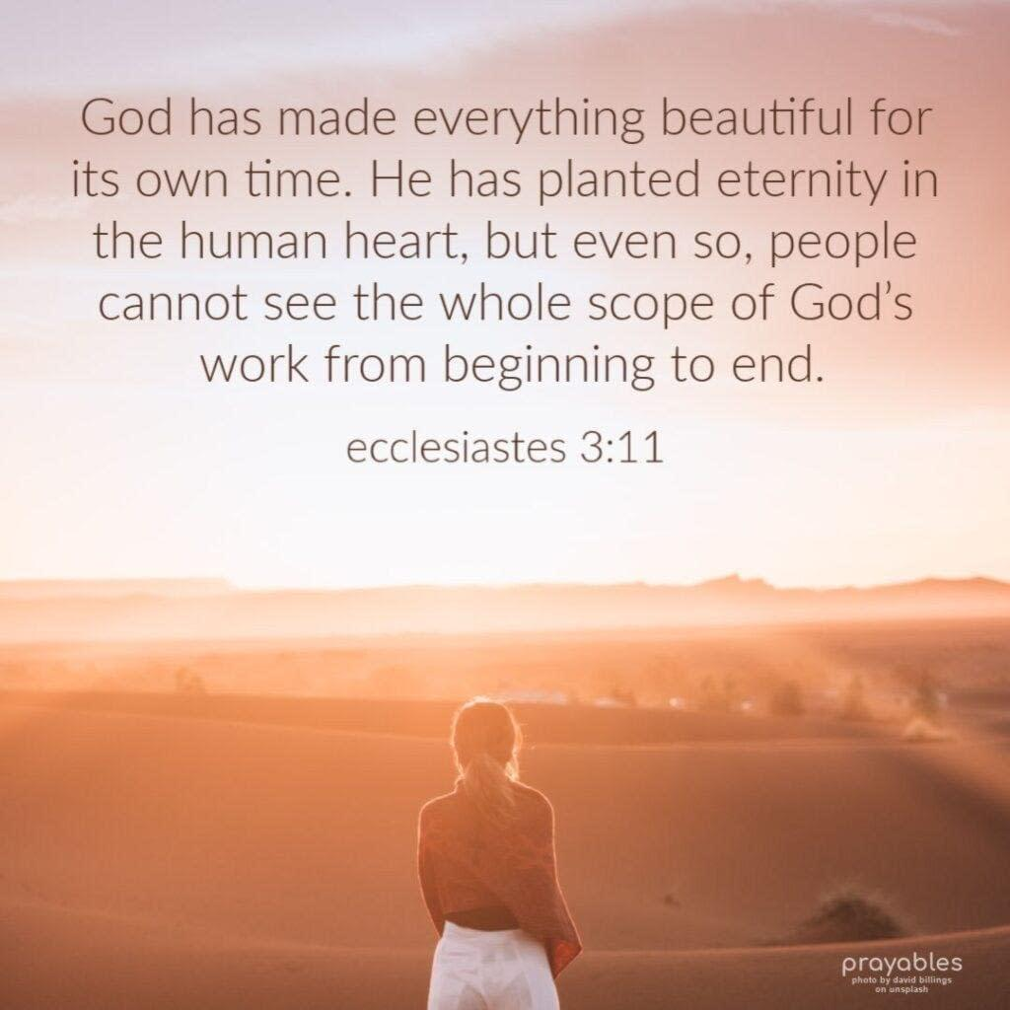

Slide 2
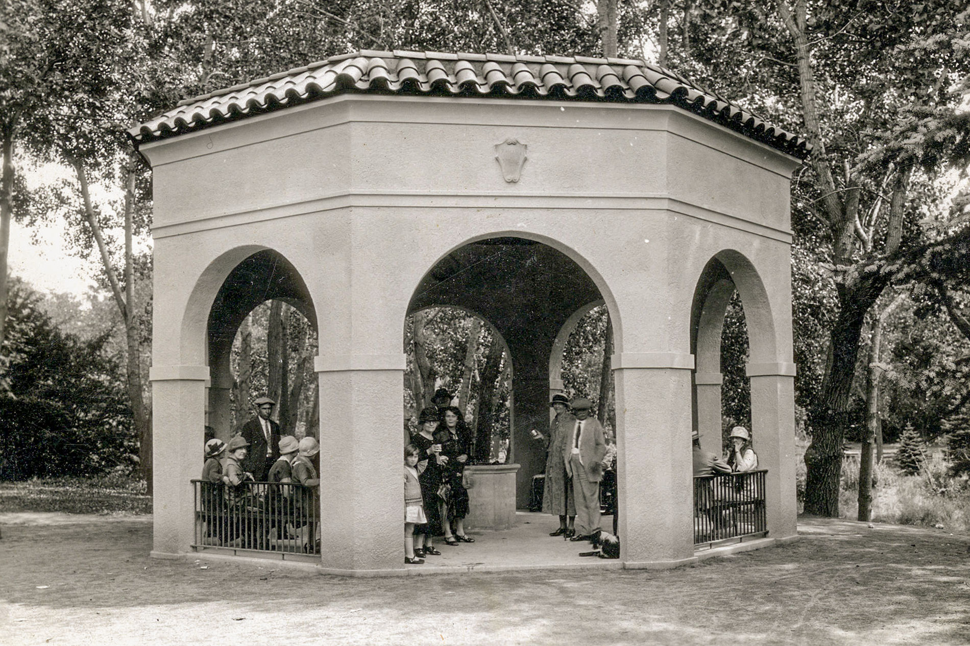
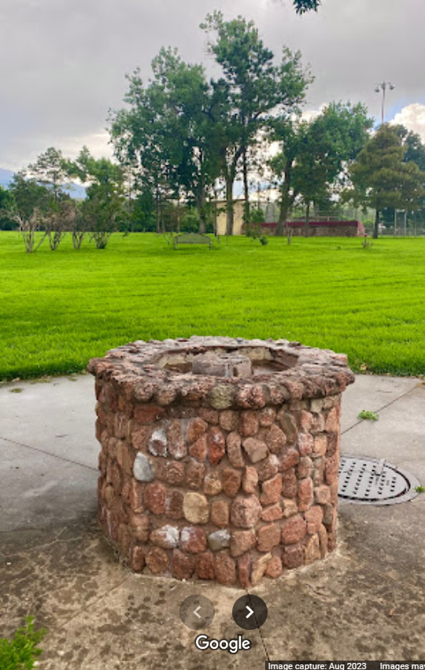
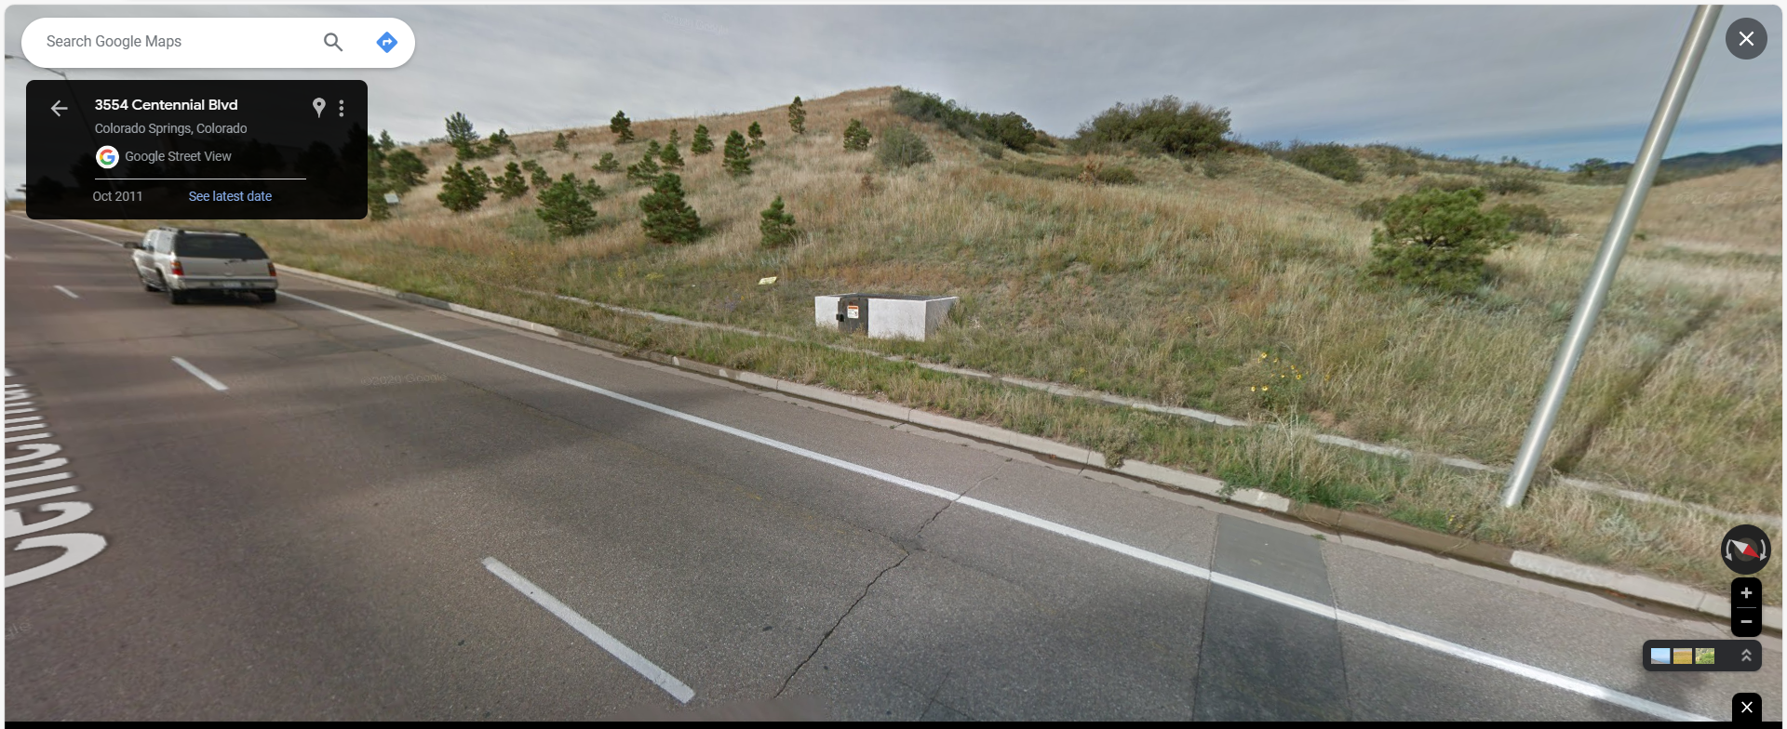

Slide 3
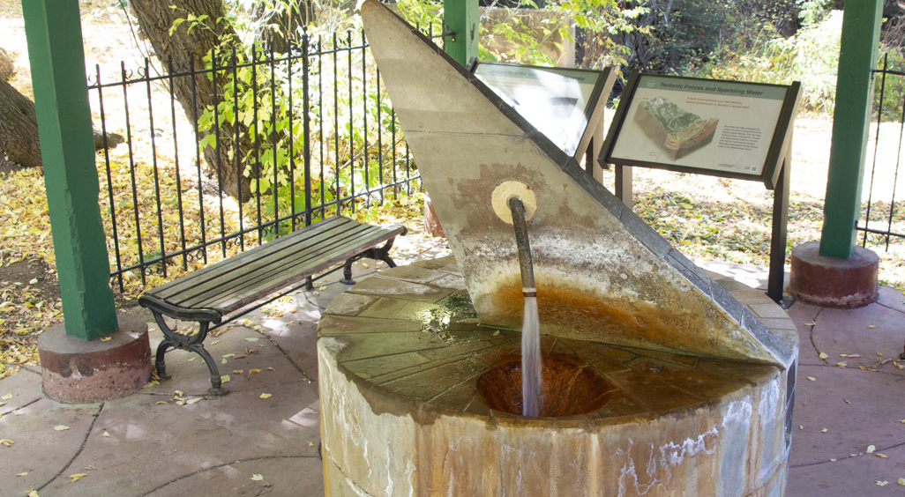
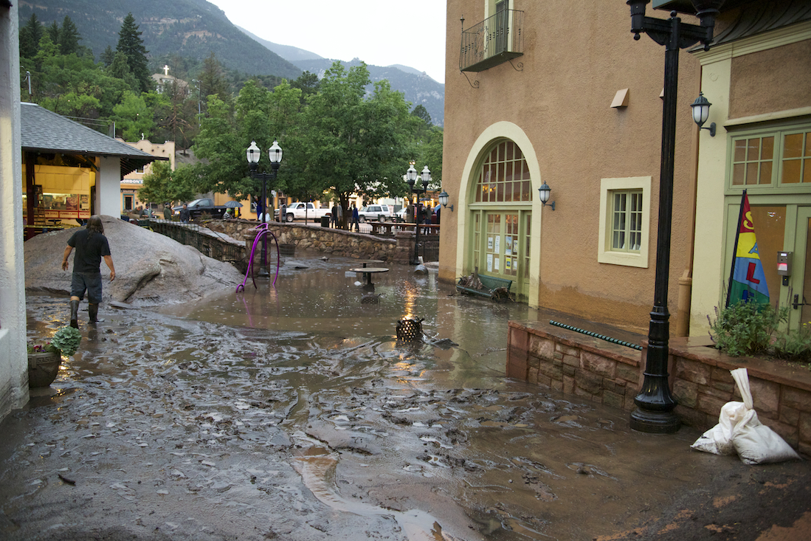
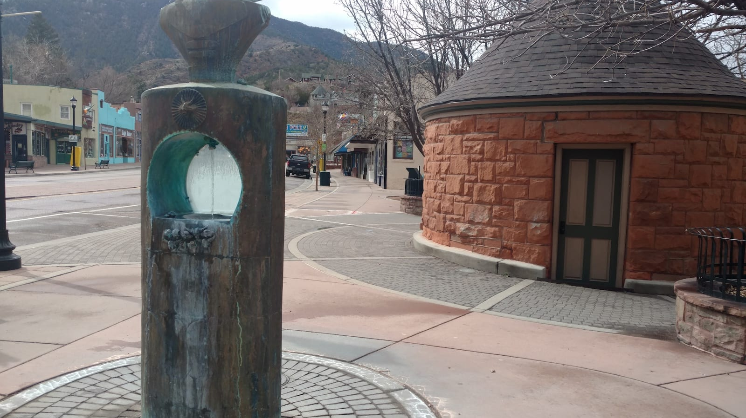

Slide 4
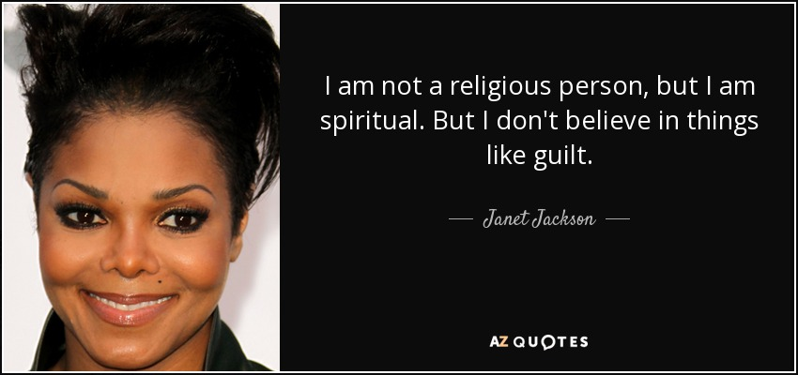
Like Jesus, Ask Good Questions
Why do people, after repeated failures, still crave Justice?
Can Spirituality ever really & truly be reined in?
Why do some religions continue to utilize war & terror?
Why do a majority of cultures have spiritual beliefs?
Why do atheists still confess to spiritual experiences?

Slide 5
Like Jesus, Ask Good Questions
Acts 14:8-18; 17:16-34]
Why do people, after repeated failures, still crave Justice?
Can Spirituality ever really & truly be reined in?
Why do some religions continue to utilize war & terror?
Why do a majority of cultures have spiritual beliefs?
Why do atheists still confess to spiritual experiences?
Wouldn’t a loving God leave signs pointing to existence?
Do words like ‘true’ still mean what they used to? Why?
Why do humans crave spirituality? What is the source?
Could the assumptions of scripture be true? [Eccl 3:9-13]
True: “In accordance with fact or reality, accurate or exact.”

