Slide 1
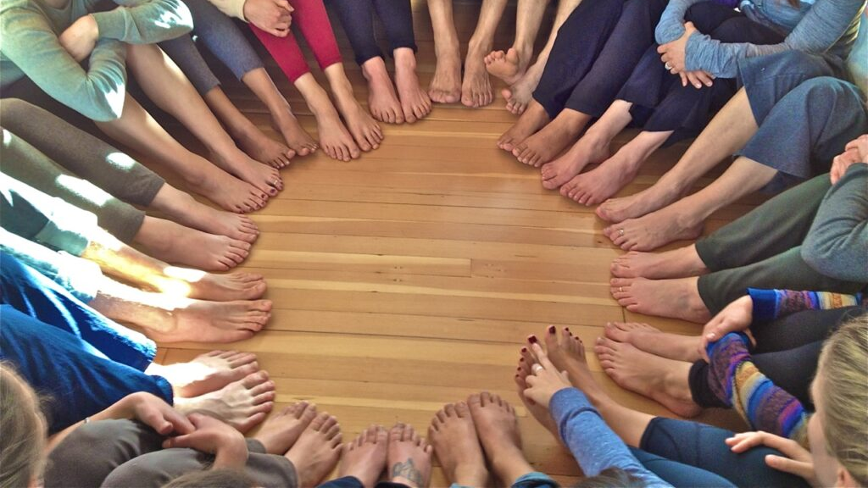
Beautiful Feet
Romans 10:15

Slide 2
Where Are The Open Doors?
All men crave justice despite repeated failures.
Most societies have had some spiritual devotion.
We work so hard at relationships which often hurt us.
Is there any reasonable explanation for these traits?

Slide 3
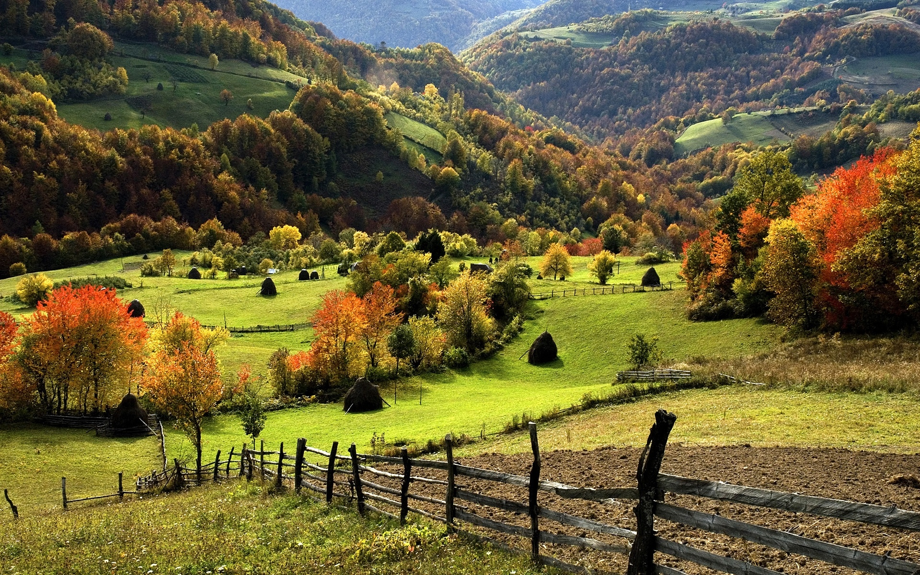
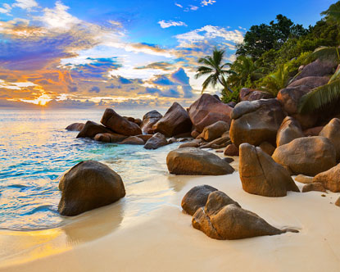
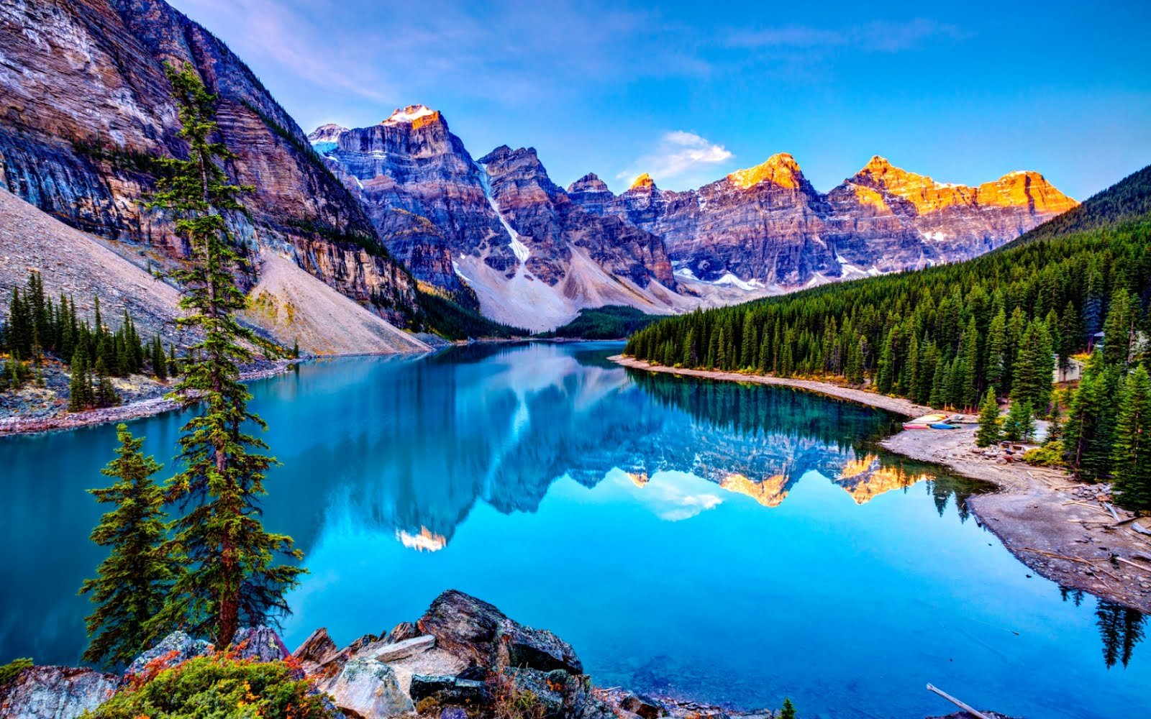
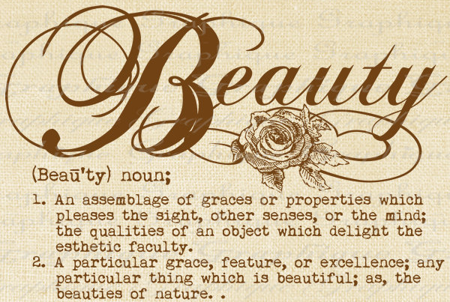
From Where Does Beauty Come?
Christians have long sung & preached about beauty.
Universally we struggle to define beauty.
Nevertheless, we all endure pain to achieve it.
Gen 2:8-9 says the world was created good & beautiful.
Aaron’s robes were to be beautiful. Ex 28:2
Psalms declares Jehovah’s beauty. [27:4; 50:2; 96:6]
Isaiah is perhaps the most intriguing [52:2-3; 33:17]
Maybe it’s the distinction external & internal beauty.

Slide 4
From Where Does Beauty Come?
Beauty, hard to define, painful to achieve, worth it.
Jehovah is regularly interested in beautiful creations.
Yet, a distinction between external & internal beauty.
Civilizations often expect their leaders to be attractive.
Hopefully, we desire inner beauty more!
This is how God defines beauty: [1 Pet 3:3-4; 2:12]
A noticeable inner transformation to living life!
Ask people what is real beauty & why?

