Slide 1
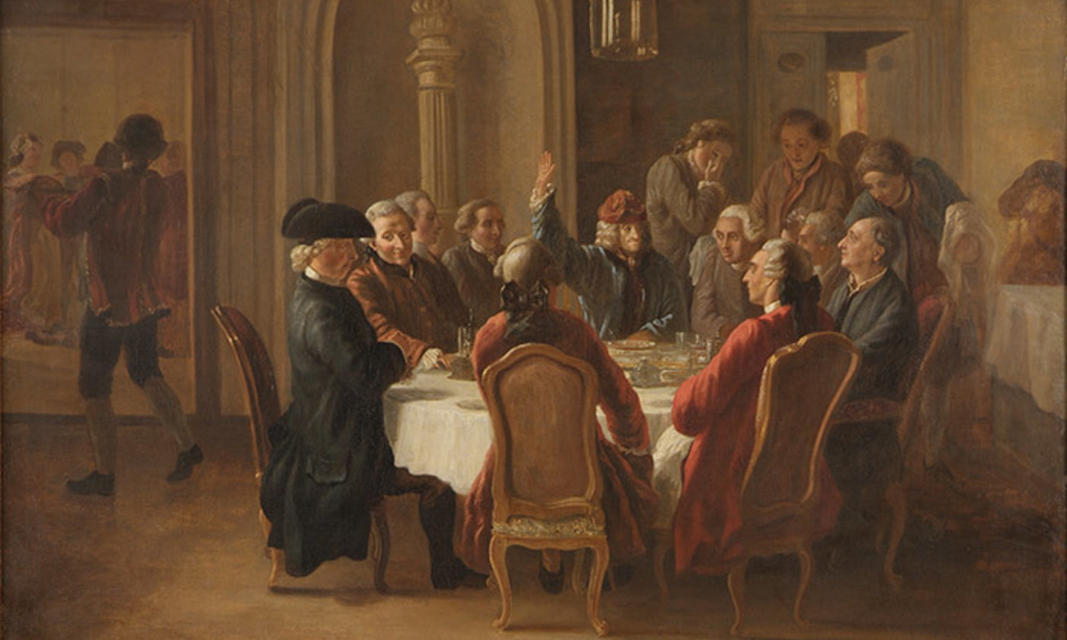
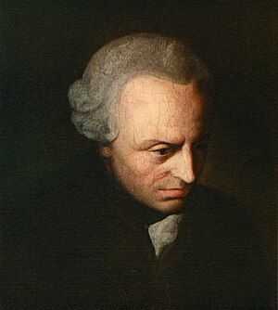
What is Enlightenment?
“Enlightenment is man’s emergence from self-inflicted immaturity. …Dare to be wise!” -1784
Immanuel Kant
On Isaac Newton’s Principia Mathematica (1687).
“Sir Newton spread the light of mathematics on a science which up to then had remained in the darkness of conjectures & hypotheses.”
-A. Clairaut, 1747

Slide 2
That The Eyes Of Your Heart Would Be Enlightened -Eph 1:8
Enlightenment language also rightly has deep religious roots.

Slide 3
Eyes Of Your Heart Enlightened -Eph 1:8
A) Paul prayed for mature conduct & BELIEF.
[Eph 1:15-19] Godly wisdom sharpens the mind. Creation points to a powerful Creator [Psm 19]. Those who refuse, darkened hearts. Rom 1
[Eph 5:3-8] Let no one deceive you. Be holy. We must work to discern God’s will. [Eph 5:8-17].
While some decisions are morally clear, some are neutral, & others require brave free-thinking.

Slide 4
Eyes Of Your Heart Enlightened -Eph 1:8
B) How Should Christians Make Decisions:
1) Scriptural Test, 2 Tim 3:16, has God clearly said Yes or No? Obey.
2) Secrecy Test, Jn 3:20, are we hiding it from others? God knows.
3) Survey Test, [1 Tim 4:12], does this set a good or bad example?
4) Spiritual Test, [Gal 1:10], is this peer-pressure or pleasing God?
5) Stumbling Test, [Ro 14:21], will this cause others to stumble?
6) Serenity Test, Php 4:6-7, has prayer delivered peace of mind?
7) Sanctification Test, [Ro 6:17-19] does this lead to sanctification?
8) Supreme Test, 1 Cor 10:31, HOW does this glorify God?

Slide 5
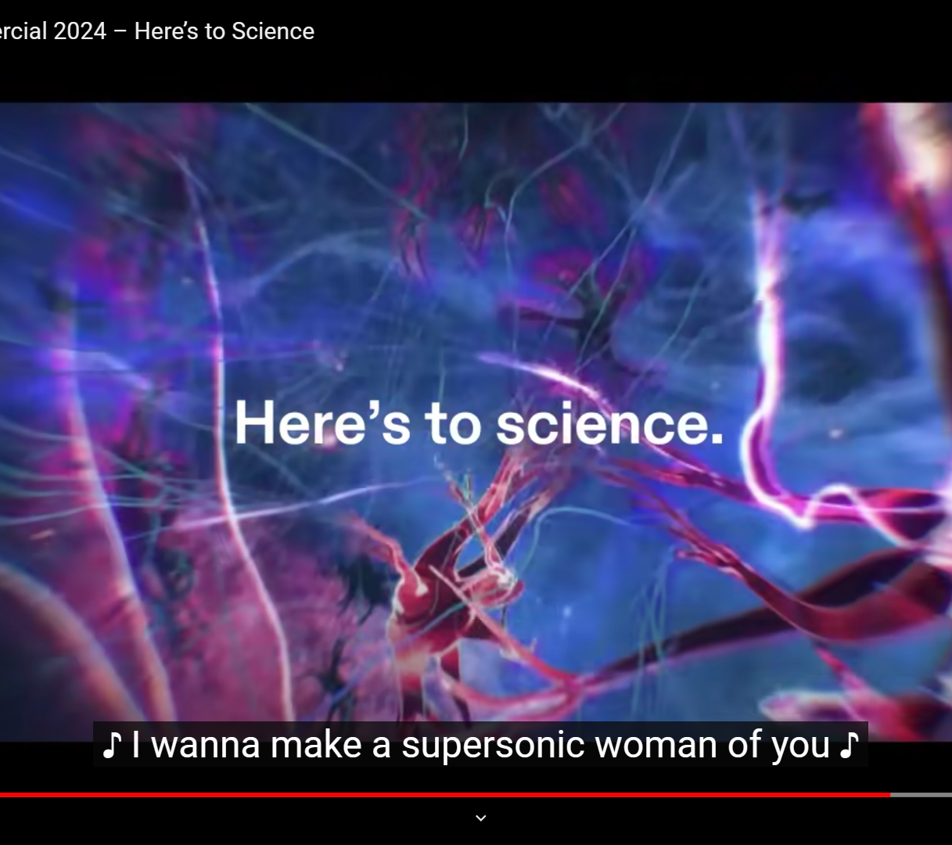
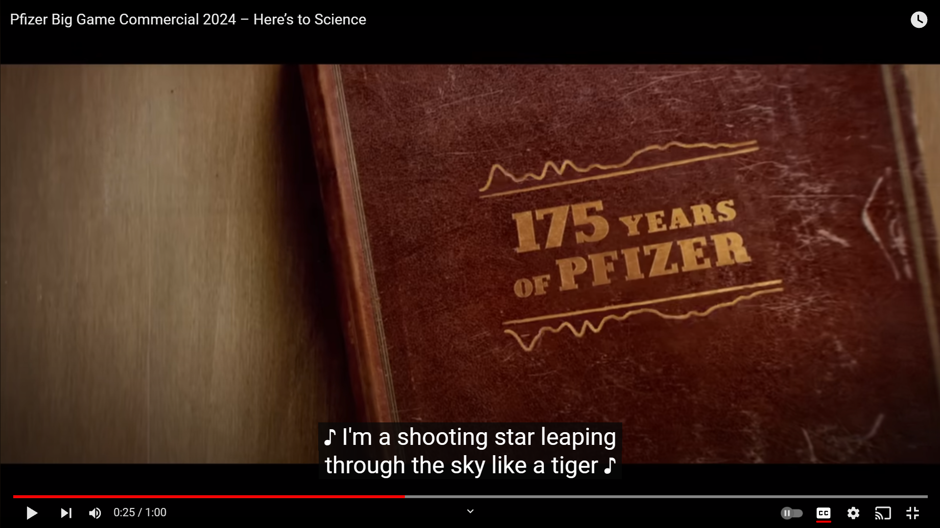
Eyes Of Your Heart Enlightened -Eph 1:8
C) The Difficulty of Applying Specifics:
We all have different gifts & knowledge. 1 Cor 8-14
Be careful: Good intentions can add rules God didn’t give.
That caution given, let’s return to enlightenment & science.

Slide 6
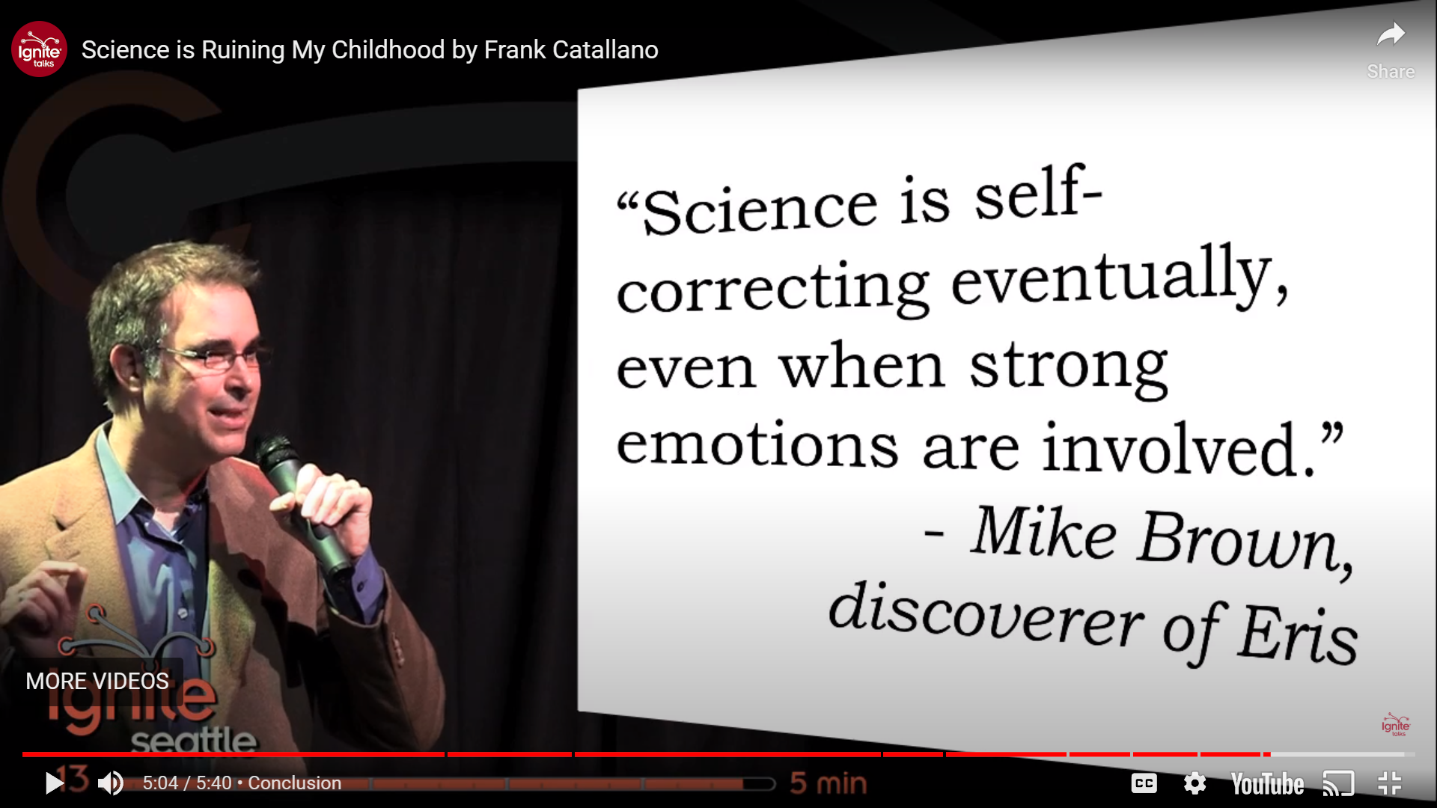
Eyes Of Your Heart Enlightened -Eph 1:8
C) The Difficulty of Applying Specifics:
We all have different gifts & knowledge. 1 Cor 8-14
Be careful: Good intentions can add rules God didn’t give.
That caution given, let’s return to enlightenment & science.

Slide 7
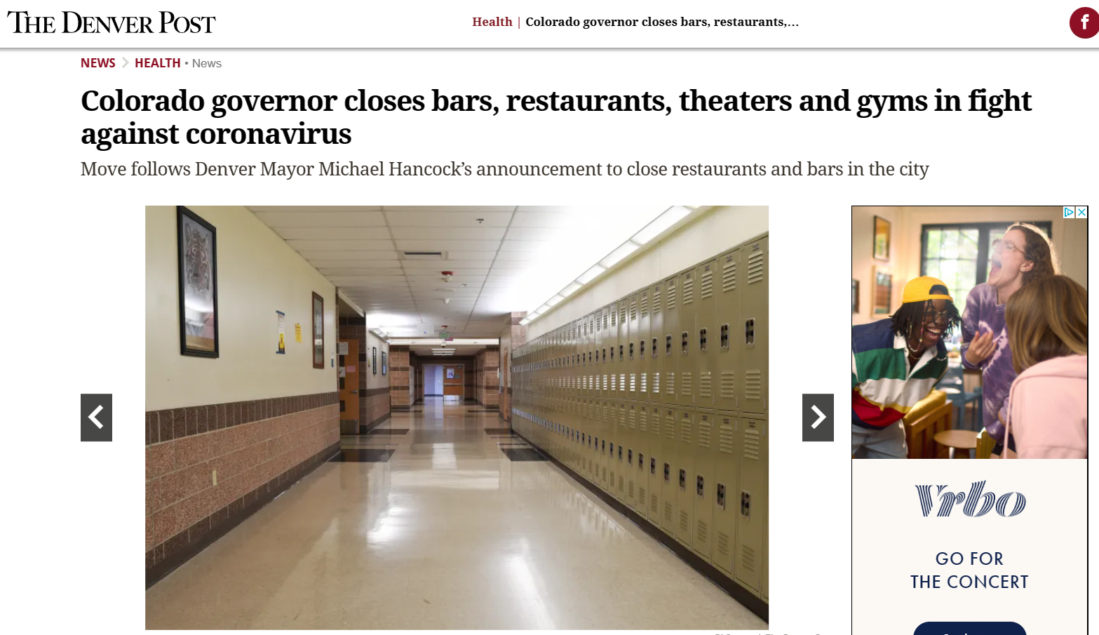
Eyes Of Your Heart Enlightened -Eph 1:8
C) The Difficulty of Applying Specifics:
We all have different gifts & knowledge. 1 Cor 8-14
Be careful: Good intentions can add rules God didn’t give.
That caution given, let’s return to enlightenment & science.
What is this generation’s 9/11 moment?
March 16
2020
When can we lovingly discuss, What were the lessons learned?

