Slide 1
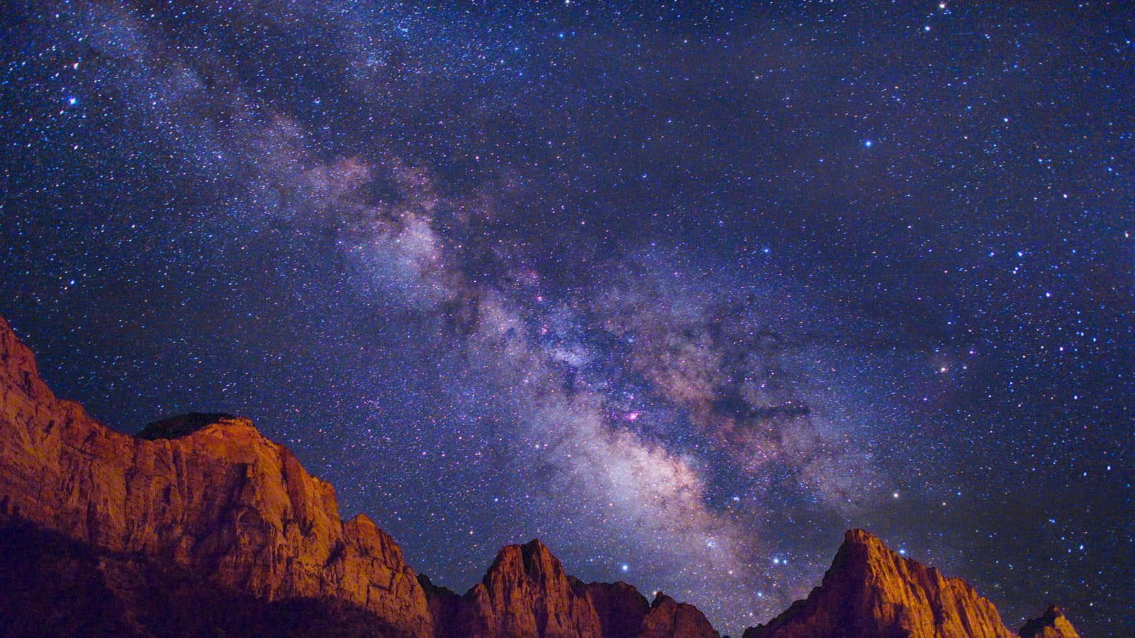
Praise YHWH The Great King of ALL Psalm 145

Slide 2
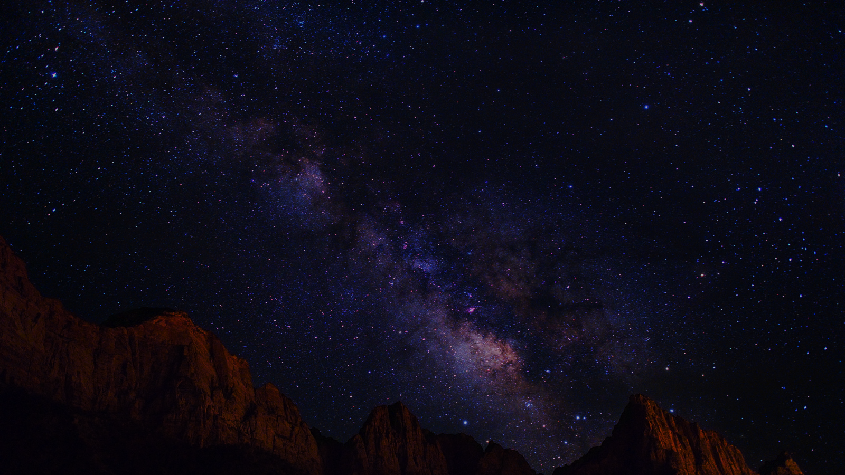
YHWH The Great King Psm 145
Last of 7 acrostic poems. Recited often at synagogues.
The intent of acrostic poems is like our “A to Z.” “The entire alphabet, the source of all words, is marshalled in praise of God.”
Outline options vary widely. Focus on “praise” & “kingdom.”
God’s Greatness Praised [v1-7]
God’s Gracious Acts/Deeds v8-14
God Gives To His People v15-21
Where is Jesus in this psalm?

Slide 3
YHWH The Great King Psm 145
God’s Greatness Praised [v1-7]
Do we lift Him up & meditate on His name daily?
Have we told the next generation about His greatness?
His works of creation & powerful deliverance of Israel.
Their children memorized Exodus 34:6-7. Have we?
God’s Gracious Acts/Deeds v8-14
God Gives To His People v15-21

Slide 4
YHWH The Great King Psm 145
God’s Greatness Praised v1-7
God’s Gracious Acts/Deeds [v8-14]
Verses echoing Ex 34 are all throughout OT [Jonah 4:1-4]. God is good to ALL & His Kingdom is eternal. He is morally good; He delivers the needy & oppressed. He sees us downcast & is willing to lift us up, bless us.
God Gives To His People v15-21

Slide 5
YHWH The Great King Psm 145
God’s Greatness Praised v1-7
God’s Gracious Acts/Deeds v8-14
God Gives To His People [v15-21]
Those who call Him truly in love & fear, He’ll be near!
Like a good farmer He cares for all His animals.
May God help us to continually praise His name.

Slide 6
YHWH The Great King Psm 145
God’s Greatness Praised v1-7
God’s Gracious Acts/Deeds v8-14
God Gives To His People v15-21
King Jesus in Psalm 145?
His prayer in Matthew 6 includes much of the language here: Kingdom, forgiveness, etc.

